Slide 1
Enterprise Technology
Bank Data Operations Team
May, 2019
Notes:
Please copy/paste the Discover logo from the Cover layout master slide (see: View > Slide Master).

Slide 2
Enterprise Technology Data Operations
Agenda
Enterprise Technology Team Composition
Discover Personal Loans / Discover Home Equity Loans / LOC / MAD / Neustar
  Description of the Business
  Team Composition
  Goals
Discover Student Loans
  Description of the Business
  Team Composition
  Goals
Deposits / Deposits Fraud / FODS
  Description of the Business
  Team Composition
  Goals
Bank Data Ops Technology / Performance
Work
Notes:
Placeholder: Introduction slide.

Slide 3
Enterprise Technology Data Operations
 | Rupa Narayan Director, Bank Data Ops | Jingsi Xia Director, Payment Data Ops | Mark Ames Director, Finance Systems Development | Todd Bruns Director, Corporate Systems Development | Chris Hardman Director, Data Support
Focus | Data transformation development and management for Bank Value Streams: DPL/DHE DSL Deposits Marketing Analytics Database (MAD) Neustar (DSDK) | Data transformation development and management for Payments business unit | Finance systems development and management (Finance Modernization, CECL, CCAR, etc.) Data transformation development and management for Finance staff group | Data transformation development and management for AML, Risk, Audit, Compliance, H, BT Cyber | L1 production support for all data ops L1 production support ET applications Delivery process standardization and process improvement ETL Tools Product Owner
Stakeholders | Cloud data platform teams Enterprise planning Bank Value Streams | Cloud data platform teams Enterprise planning Payments Value Streams | Cloud data platform teams Enterprise planning Finance, Treasury | Cloud data platform teams Enterprise planning AML, Risk, Audit, Compliance, HR, Cyber | Cloud data platform teams Enterprise planning Data Ops teams ET application teams SDLC team
Senior Managers | Suresh Appavu, Sr. Mgr – DPL/DHE Data Ops Alice Bodner, Sr. Mgr – DSL Data Ops Samantha Liu, Sr. Mgr, Deposits Data Ops Lakshmi Puttagunta, Sr. Principal Business Architect Suganya Prathap, Sr. Principal IT Project Mgr | Radhika Srinivasan, Sr. Mgr - Payments Data Ops Cindy Bai, Sr. Principle Business Architect | Mike Foye, Sr. Mgr – Finance Distributed Apps Beth Young, Sr. Mgr – Finance Modernization Mark Goldstone, Sr. Mgr – Finance Gen Account Aps Karen Duckett – Sr. Mgr – Finance Data and Reporting | Brian Hatfield, Sr. Mgr – CRM Data Ops Vivek Gupta, Sr. Mgr – Corporate Systems Enterprise Applications Bina Varghese, Sr. Mgr – Enterprise Corporate Data Ops Kalle Kittelson, Sr. Mgr - Robotic Process Automation (RPA) Govind RaghunathapuramSrinivasan - Sr. Principle Bus Architect | Tom Rogers, Sr. Mgr - L1 Prod Support for Data Ops Open Sr. Mgr - L1 Prod Support – ET Apps
# FTE | 29 | 16 | 22 | 41 | 2
# Open | 0 | 0 | 5 | 4 | 1
# FTC | 77 | 50 | 10 | 104 | 151
Scrum Master | Peggy Rivera (DPL/DHE), Harjeet Singh (DSL), Dhruv Mehta (Deposits, Deposits Fraud), Suganya Prathap (MAD) Architect: Erin Rice (Deposits Fraud) | Sam Serdar (DCS), Melissa Bichler (EPP), Zoe Baker (Starts Summer 2019) | Nicole McGee, Vito Alfano, Karen Kasprzycki, Sharon Malott, Latasha Hollingshed | Sarah Reid | None at this time

Slide 4
Bank Data Operations Teams
 | Suresh Appavu, Sr. Mgr, Discover Personal Loans (DPL) | Suresh Appavu, Sr. Mgr, Discover Home Equity (DHE) | Suresh Appavu, Sr. Mgr, Line of Credit (LOC) | Suresh Appavu, Sr. Mgr, Marketing Analytics Database (MAD) / Neustar (DSDK) | Alice Bodner, Sr. Mgr, Discover Student Loans (DSL)
Focus | Originations Servicing Collection & Recovery Credit Bureau MIS/Credit Risk Analytics Fraud Analytics | Originations Servicing Collection & Recovery Credit Bureau MIS/Credit Risk Analytics | Cover inadvertent OD by advancing the funds needed in Checking AC from ODP LOC Interest APR lower than other short term debt alternatives | Broad Market Analytics Portfolio Analytics Portfolio/Cross-Sell Campaign Management Marketing Campaign Performance Tracking Federal Household Mapping Audience Syndication | Originations Servicing Collection & Recovery Credit Bureau MIS/Credit Risk Analytics
FTE | 4 | 1 | 1 (Visa Trans in-progress) | 7, 1 TBH | 9
ADC | 2:4 | 0:1 | NA | NA | 2:9
Surge | 1:3 | 0:1 | 5:11 | NA | 4:23
Scrum Master | Margaret(Peggy) Rivera | Margaret(Peggy) Rivera | Dipti Wangu | TBD | Harjeet Singh
Business Parrtners/Product Owner | SVP – Samir Patel, Steve Dickerson Director - Steven Trybus, Viabhav Bhatt, Rejo Mathew, Arthur Page Product Owner – Sarita Pinto | SVP - PK Parekh Director - Stoyan Vlaikov, Rejo Mathew Product Owner - Anton Roussev | VP – Kevin Chanashing Director – Brian Wynn Product Owner – Mark Leszczynski | TBD | SVP - Katherine Manfred, Steve Dickerson VP – Nicole Straub, Kevin Chanashing, Krishnan Srinivasan, Vivek Padmanaban Director – Heather Thompson, Barbara Vanbramer, Abhishek Yadav, Rejo Mathew, Neil Ni, Mike Sofranko Product Owner – Alex Payne
Technology Stakeholders | Rupa Narayan - ET Bank Data Ops Cindy Deyhle, Dave Bulgart – App Development | Rupa Narayan - ET Bank Data Ops | Rupa Narayan – ET Bank Data Ops Valeria Utsis – App Development | Rupa Narayan – ET Bank Data Ops | Rupa Narayan - ET Bank Data Ops Valeria Utsis, Dave Bulgart – App Development

Slide 5
Bank Data Operations Teams
 | Samantha Liu, Sr. Mgr, Deposits | Samantha Liu, Sr. Mgr, Deposits Fraud | Samantha Liu, Sr. Mgr, FODS
Focus | Originations Servicing Cash Edge/Pep + Brokered/Non-Brokered Account Center Debit Cards Campaign Data Daily Summary tables | Finacle near-real time 3rd party vendor – Threat Metrix, Lexis Nexis, Bill Pay, Neustar, Experian, Vantiv, etc. Calypso referrals Almanac, Documentum data Blaze Decision Engine application data | Finacle Operational Data Store for Deposits and DPL Deposits Alerts AC Lite data files
FTE | 3 | 2 | 0
ADC | 1:4 | 0:6 | 2:5
Surge | 0 | 2 | 0
Scrum Master | Dhruv Mehta | Dhruv Mehta | Dhruv Mehta
Business Parrtners/Product Owner | SVP – Tod Gordon VP – Arijit Roy, Ram Subramanian Director – Vincent He Product Owner - Alex Morsov | SVP – Tod Gordon VP – Arijit Roy, Ram Subramanian Director – Tushar Mutatkar Product Owner – Vijaychandra Boppana | SVP – Tod Gordon VP – Arijit Roy, Ram Subramanian Director – Vincent He
Technology Stakeholders | Rupa Narayan - ET Bank Data Ops Robyn Schneider, Dave Bulgart – App Development | Rupa Narayan - ET Bank Data Ops Robyn Schneider, Dave Bulgart – App Development | Rupa Narayan – ET Bank Data Ops Robyn Schneider, Dave Bulgart – App Development

Slide 6
DPL/DHE Team Overview – Suresh Appavu
Definition/Purpose:
Support Discover Personal Loans (DPL) line of business - loans which are unsecured, have a fixed rate and term, no origination fees, and are used to consolidate debt or pay for life's big events.
Support Discover Home Equity loans (DHE) line of business – loans having a fixed rate, term, and monthly payment ranging from $35K - $150K that allows borrower to use value of his/her home as collateral.
Support Line Of Credit Initiative – a new Line of Credit product that will include Overdraft Protection features.
Marketing Analytical Database (MAD)/Neustar (DSDK) - an enterprise-wide marketing technology architecture
DMS Adoption:
Daily stand-ups, daily collaboration sessions, weekly huddles, problem solving meetings
Program Increment (PI) events, retrospectives,
Scrum of scrum (SoS) meetings, PO/PM/SM synch meetings

Slide 7
DPL Team Overview – Suresh Appavu
Team Composition:
4 FTE
6 ADC
In-Sourcing/Recruitment Plans:
Release 1 ADC effective 5/31
Plan to convert 1 ADC resource by Q3
Release 1 ADC resources by end of June
Name | Role | Type
Suresh Appavu | Sr. Manager | FTE
Margaret (Peggy) Rivera | Scrum Master | FTE
Sarita Pinto | Product Owner - DPL | FTE
Sivakumar Nachimuthu | Lead Data Engineer | FTE
Mark Olson | Data Engineer | FTE
Lee Collins | Data Engineer | FTE
Ankansha Singh | Data Engineer | ADC
Fakruddin Ummar | Data Engineer | ADC
Pratik Ghorpade | Data Engineer | ADC
Komal Bhatiya | Data Engineer | ADC
Supriya Agrawal | Data Engineer | ADC
Rajat Chawla | Data Engineer | ADC
* Sr. Managers not included in counts

Slide 8
DHE Team Overview – Suresh Appavu
Name | Role | Type
Suresh Appavu | Sr. Manager | FTE
Margaret (Peggy) Rivera | Scrum Master | FTE
Anton Roussev | Product Owner – DHE | FTE
Sachin Barapatre | Data Engineer | FTE
Rahul Pancholi | Data Engineer | ADC
Shubhangi Sangnale | Data Engineer | ADC
Team Composition:
1 FTE
2 ADC
In-Sourcing/Recruitment Plans:
Release 1 ADC resource by end of 2019
* Sr. Managers not included in counts

Slide 9
Marketing Analytics (MAD) Team Overview – Suresh Appavu
Name | Role | Type
Suresh Appavu | Sr. Manager | FTE
Suganya Prathap | Scrum Master | FTE
Jacob Gutierrez | Data Engineer | FTE
Jashwanth Yenumula | Data Engineer | FTE
Marvin Abarca | Data Engineer | FTE
Ganga Vijendran | Data Engineer | FTE
Kabindra Senapati | Data Engineer | FTE
Ryan Stevens | Data Analyst | FTE
Jeffrey Adams | Data Analyst | FTE
Team Composition:
7 FTE
In-Sourcing/Recruitment Plans:
1 open to be hired by Q3
* Sr. Managers not included in counts. Scrum Master not included in MAD count.

Slide 10
DPL/DHE Team Overview – Suresh Appavu
What does winning look like in 2019:
Provide data to enable improved model implementations for credit decisioning (Zest), allowing DFS to evaluate applicants and expand our reach to serve new customers (DPL)
Enable data within analytics environment for Overdraft Line of Credit product, which covers inadvertent overdrafts by advancing the funds needed in the protected (checking) account from the overdraft line of credit (ODP LOC). This effort supports broad-market growth of DFS’s low-cost funding source, develops a consumer banking experience with revolving credit, and allows business teams to consume the data for Finance & Compliance Reports & Models. (LOC)
Provide improved data analytics capabilities by adding additional attributes from originations vendor, NetOxygen, into production analytics environment (DHE)
Develop marketing analytics capabilities by providing digital data sources (existing and external) in Snowflake (MAD)
What are we teeing up for the future:
Improve operational efficiency by onboarding partners through Impact vendor, providing an approximate savings of $4.8MM (DPL)
Provide additional data analytics capabilities by adding data attributes from Wipro into production analytics environment (DHE)
Continue to develop marketing capabilities via MAD initiatives

Slide 11
DSL Team Overview – Alice Bodner
Definition/Purpose:
Support Discover Student Loans (DSL) line of business – loans used to pay for school–related expenses, typically college expenses, including undergraduate, graduate, and consolidation loans.
DMS Adoption:
Daily stand-ups, daily collaboration sessions, weekly huddles, problem solving meetings
Program Increment (PI) events, retrospectives,
Scrum of scrum (SoS) meetings, PO/PM/SM synch meetings

Slide 12
DSL Team Overview – Alice Bodner
Team Composition:
9 FTE
11 ADC
In-Sourcing/Recruitment Plans:
Release 5 ADC resources by end of 2019
Name | Role | Type
Alice Bodner | Sr. Manager | FTE
Hargeet Singh | Scrum Master | FTE
Alex Payne | Product Owner | FTE
Julius D’Souza | Lead Data Engineer | FTE
Arif Khan | Lead Data Engineer | FTE
Avishek Roy | Lead Data Engineer | FTE
Irfan Syed | Sr. Data Engineer | FTE
Srinivas Lakkireddy | Sr. Data Engineer | FTE
Janet Xu | Sr. Data Engineer | FTE
Nathan Chen | Data Engineer | FTE
Umaima Sipwala | Data Engineer | FTE
BitWise | On-site L3 Support (1) Off-shore L3 Support (4) | ADC ADC
BitWise | On-site PA L1 Support (1) Off-shore PA L1 Support (5) | ADC ADC
* Sr. Managers not included in counts

Slide 13
DSL Team Overview – Alice Bodner
What does winning look like in 2019:
Provide data to enable improved model implementations for DSL models, improving originations and servicing capabilities
Implement 25% of SDM enhancements to provide improved data capabilities for Student Loan business partners
What are we teeing up for the future:
Complete remaining SDM enhancements, providing overall improved data capabilities (TBD)
Move existing data from sandbox environment to standardized, fully supported production tables. This will provide improved data capabilities for our business partners

Slide 14
Deposits Team Overview – Samantha Liu
Definition/Purpose:
Support Discover Deposits line of business – checking, savings, money market, CDs, and IRAs.
Support Discover Deposits Fraud application – support of DW processes making data available to detect fraudulent activity among Discover deposit applications, accounts, and transactions.
Support FODS application – support of Finacle Operational Data Store, including processes, servers, and testing environment, making source Deposits and DPL data available in DW.
DMS Adoption:
Daily stand-ups, daily collaboration sessions, weekly huddles, problem solving meetings
Program Increment (PI) events, retrospectives,
Scrum of scrum (SoS) meetings, PO/PM/SM synch meetings

Slide 15
Deposits Team Overview – Samantha Liu
Team Composition:
5 FTE
7 ADC
In-Sourcing/Recruitment Plans:
4 FTE hired with start dates in June and July
Plan to hire 2 FTE by end of year
Plan to hire 3 FTE by Q1 2020
Name | Role | Type
Samantha Liu | Sr. Manager | FTE
Dhruv Mehta | Scrum Master | FTE
Alex Morsov Vijay Boppana | Product Owner – Deposits Product Owner – Deposits Fraud | FTE FTE
Erin Rice | Principal Systems Analyst | FTE
Brian Gross | Lead Business Data Analyst | FTE
Angie Fang | Sr. Data Engineer | FTE
Ayesha Naseem | Data Engineer | FTE
BitWise | On-site Deposits Support (1) Off-shore Deposits Support (4) | ADC ADC
BitWise | Off-shore Deposits Fraud Support (6) | ADC
BitWise | On-site FODS Support (2) Off-shore FODS Support (5) | ADC ADC
* Sr. Managers not included in counts

Slide 16
DepositsTeam Overview – Samantha Liu
What does winning look like in 2019:
Money Movement changes which will improve our customer’s ability to move money more quickly
Project Taylor will provide new features to allow our customers creative ways to save with us
Provide data within analytical environment for Zelle P2P, giving our customers a way to transfer money to people within Zelle network and making DFS more competitive within the deposits market
Provide automated solutions of manual fraud business processes, improving process controls, providing for standards and data quality, production support, and allowing business more time for other key business functions
What are we teeing up for the future:
Provide data to enable implementation of bank fraud models, enhancing deposits originations capabilities
Migration of SAS strategies to FICO DMP, providing simpler and faster decisions, less dependency on other teams, a cloud-based environment with capabilities to scale economically, and increased decision accuracy through powerful data analytics (TBD)

Slide 17
Bank Data Ops Team – Common Goals
What does winning look like in 2019:
Unify and simplify bank servicing data pipeline
  Hadoop Migration by end of the year
  FODS Migration (TBD)
  Continue to move all bank data assets towards the cloud
Operational resiliency:
  Reduce abends by 50%
  Meet banking critical and key core application SLAs 90% of the time
  Meet banking support application SLAs 80% of the time
  Reduce DQ overrides to 0
Team and process development:
  Establish teams, processes and metrics per DMS structure and drive operational efficiencies and improve productivity
  Develop credible relationships with all bank partners and improve interactions with BT partners

Slide 18
Bank Data Ops Technology/Performance
 | Discover Personal Loans (DPL) | Discover Home Equity (DHE) | Line of Credit (LOC) | Discover Student Loans (DSL) | Deposits | Deposits Fraud | FODS
Acquisitions / Originations | Discover Loan Origination System (DLOS) | NetOxygen | Finacle | Discover Student Loan Originations (DSLO) | Finacle | Finacle | Finacle
Servicing | Finacle | Dovenmuehle | Finacle | Finacle | Finacle | Finacle | N/A
Collections | ECS | Dovenmuehle | ECS | ECS | N/A | N/A | N/A
Recovery | Debt Manager | Dovenmuehle | Debt Manager | Debt Manager | N/A | N/A | N/A
Marketing | Neustar | N/A | N/A | N/A | N/A | N/A | N/A
Total Jobs | 2040 | 400 | TBD | 7200 | 1000 | 600 | 1130

Slide 19
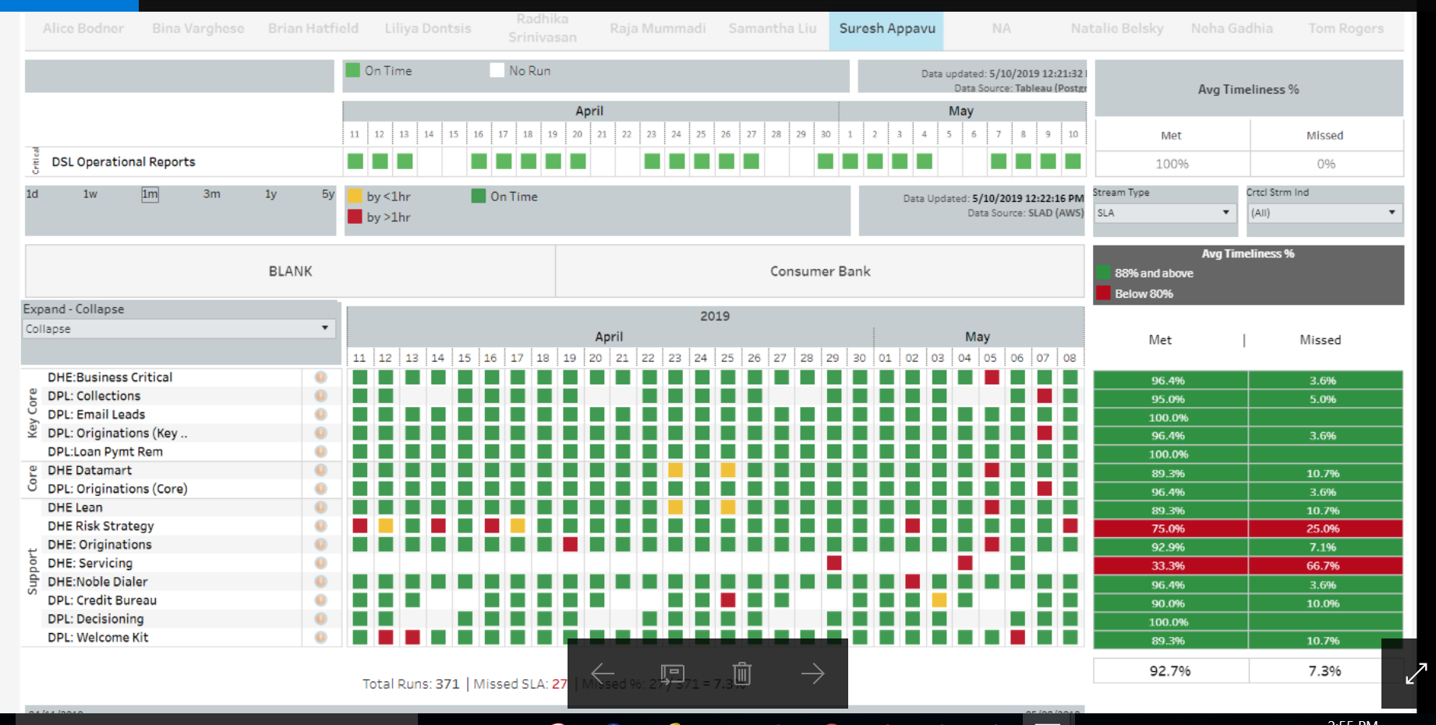
Bank Data Ops Technology/Performance
SLA/SLO Dashboards for DPL/DHE Applications

Slide 20
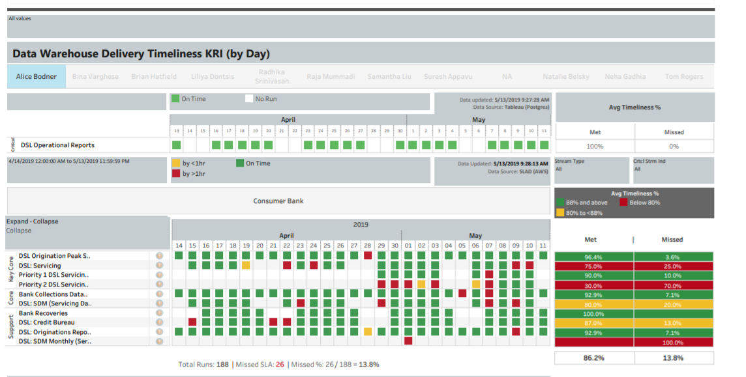
Bank Data Ops Technology/Performance
SLA/SLO Dashboards for DSL Applications

Slide 21
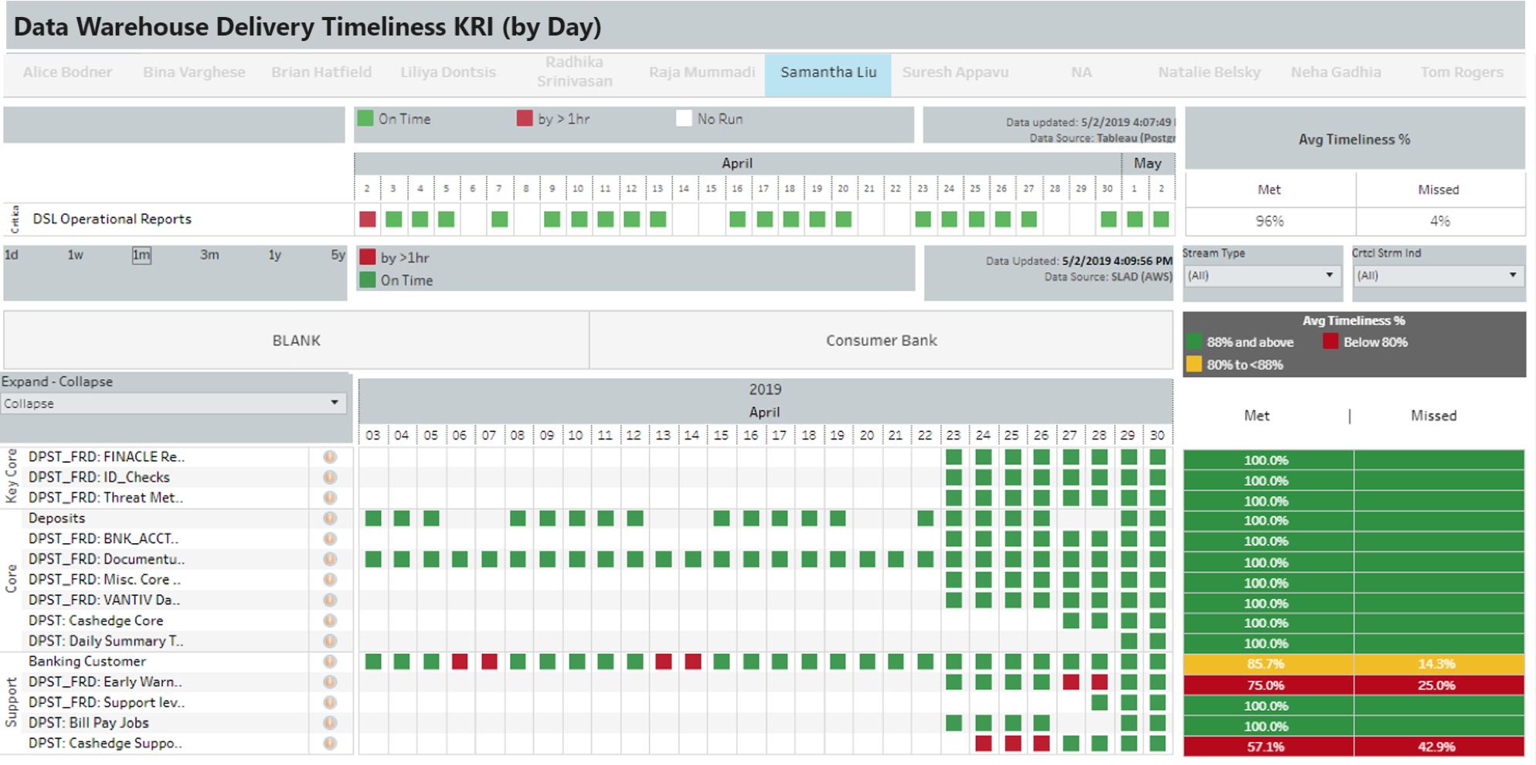
Bank Data Ops Technology/Performance
SLA/SLO Dashboards for Deposits Applications

Slide 22
DPL Technology/Performance Overview
Open Incidents – May MTD
 | Discover Personal Loans (DPL) | Discover Home Equity (DHE) | Discover Student Loans (DSL) | Deposits | Deposits Fraud | FODS
Incidents Open from Prior Months | 2 | 0 | 30 | 1 | 1 | 0
Total Incidents Opened in May | 55 | 10 | 27 | 6 | 17 | 19
May Abends | 49 | 9 | 22 | 5 | 14 | 14
May Business Initiated/Other Incidents | 6 | 1 | 5 | 1 | 3 | 5
May Incidents Closed | 54 | 10 | 20 | 3 | 15 | 19
Incidents Remaining Open | 3 | 0 | 37 | 4 | 3 | 0
* Call Alter incidents not included in counts

Slide 23
Appendix

Slide 24
DPL Team Work
Work In Progress
Project | Scheduled State
[DPL Tech Dept] - PRT_ATTR_HIST Backfill and Decommission as a part of Capstone Retirement | In-Progress
[DPL Tech Debt] Creation of 8 generic IDs for DLOS datawarehouse | In-Progress
[DPL ] Mock Data file and trigger file with Timestamp | In-Progress
[Tech Debt DPL] Optimize schedule & job HLQ rewrite Enterprise Customer & Finacle | In-Progress
Adding a script to check the load of dpl_slctn_evnt | In-Progress
[DPL PI6] INC13132771-CRITICAL - EDW WSC Table Update (MSTO; UAT - 4/29; Install - 6/16) | In-Progress
[DPL INC] Spike DPL Recovery Table | In-Progress
[DPL INC13519733] - There is a record in the MSTR_APLN_ID field with the value 'QT000_Complete' in multiple Blaze production Tables. | In-Progress
[DPL INC13553902] DPL Data correction in teradata | In-Progress
[DPL PI6] Spike-Finacle 6 day batch Analysis 4 [ Finacle Source files] | In-Progress
[DPL PI 6] - ETL Only - Paid media reporting to Impact Raidus (Install TBD) | In-Progress
[DPL PI6] New DLOS field in CNSMR_CR - RATE_RDC_OFFR_IND (MSTO; UAT - 4/29; Install - 6/16) | In-Progress
Save the memo and indicator in the teradata Install 5/7 TSYS | In-Progress
4506-T data to EDW Install 5/7 TSYS | In-Progress
[DPL INC13364717] - Data Issue in two Teradata tables BNK_LOAN_ACCT_MTHLY_SNP and BNK_LN_CO_AND_RCV_SUM_HIST | In-Progress
[DPL INC] INC13381202: FDIC - Address LN_1_ADR from V_CLB_BASIC.ADR_DTL_HIST not populated in 12 C tables | In-Progress
DPLT_ADR_DTL_HIST_DQ_POST and DPLT_APLN_EMPT_HIST_DQ_POST failures | In-Progress
Addition of 4 columns to T_EDW4. BNK_LOAN_ACCT_DLY_SNP - first priority - Install date 5/30/2019 | In-Progress

Slide 25
DPL Team Work
Work In Backlog
Project | Schedule State
Bky Discharge -Finacle/CDS to ECS Updates Project- ECS File to EDS | Backlog
[DPL] permanent fix for Job Abend CMDQ_IDS_DPL_APLN_POST | Backlog
[DPL INC] INC13329208: DPL accounts missing in Teradata table V_CLB_BASIC.DPL_APLN_TRSFR | Backlog
Blaze logs to EDW | Backlog
Blaze logs to EDW | Backlog
Blaze logs to EDW | Backlog
Blaze logs to EDW | Backlog
[DPL PI5] - Include Campaign source code attribution | Backlog
[DPL] [PI4] Create CLBO Customer Satisfaction Survey File to Telesight | Backlog
[DPL PI5] Priority 1: Send web target file to Sizmek | Backlog
(Copy of) [DPL PI 6] - : [ETL Only] Update Leads File to Oracle | Backlog
EDW impacts for BI Batch server Migration - Bank Loan Payment Reminder PT 1 - PLACEHOLDER | Backlog
EDW impacts for BI: Batch server Migration - Bank Loan Payment Reminder PT 2 - PLACEHOLDER | Backlog
[DPL Tech Debt] - Create views on Snowflake for table SCR_VAL_HIST | Backlog
Project | Schedule State
[DPL] Adhoc Support] [R&B] Adhoc activities to run the business) 05/01 - 05/31/2019 | Backlog
[DPL Tech Debt] Modifications to DPL Job Master File - DFTP information | Backlog
[DPL Tech Debt] HLQ rewrite for FIN_FODS | Backlog
[DPL Tech Debt] Need to do analysis for HNC_ID and CAPSTONE_ID Field | Backlog
[DPL Tech Debt]Monitoring/Fixing - prospect information and solicitation event modification | Backlog
[DPL Tech Debt] DPL long running jobs optimization | Backlog
[DPL Tech Debt] Alerting mechanism For all DPL SALs | Backlog
[DPL Tech Debt] Analyze DPL_DM_*files from axiciom | Backlog
[DPL Tech Debt] S_BAS Tables to Retire as a part of Capstone Retirement | Backlog
[DPL Tech Debt] Snowflake Education preparation | Backlog
[DPL Tech Debt Spike] - Analysis and Usage of table S_BAS.DPL_ACCO_NUM_REF table | Backlog
New DLOS EDW Table Clean-up | Backlog
[DPL PI6] Metro2 dftp setup for IDA | Backlog
Lexis Nexis - Read from Maria db to S3 using Abi | Backlog
Clarity - Read from Maria db to S3 using Abi | Backlog
Trended - Read from Maria db to S3 using Abi | Backlog
[DPL PI 6] - ETL Only - Validate partner leads file with Oracle | Backlog
[DPL PI6] - Neustar file Revision | Backlog
[DPL PI6] PYMT Return Payment Representment - EDS receiving data - PLACEHOLDER | Backlog
[DPL PI 6] NSF Representment (CR114P) - EDS/EDW Engagement (placeholder) - Analysis/Code | Backlog
F40143 CDM DPL: DATA SOURCING - PI6 - EDS - OM2X_Changes - 19.7 - Install TBD | Backlog
F40143 CDM DPL: DATA SOURCING - PI6 - EDS - OM2X_Changes - 19.8 Install TBD | Backlog
F40143 CDM DPL: DATA SOURCING - PI6 - EDS - OM2X_Changes - 19.9 Install TBD | Backlog
F40143 CDM DPL: DATA SOURCING - PI6 - EDS - OM2X_Changes - 19.10 Install TBD | Backlog
[DPL PI5] - (Spike) Analysis and data model of Simility data for Snowflake | Backlog
[DPL PI5] - Create ETL process to load Simility data in Snowflake | Backlog
[DPL PI6] Finacle 6 day batch mapping changes and development | Backlog
(Copy of) CDM DPL: XXX - DWH | Backlog
DPLS15 - Cell Consent and Revocation Reconciliation Report - EDS - ANALYSIS ONLY - SEPTEMBER RELEASE REQUESTED | Backlog
DPLS15 - Cell Consent and Revocation Reconciliation Report - EDS - PLACEHOLDER FOR WORK - SEPTEMBER RELEASE REQUESTED | Backlog

Slide 26
DHE Team Work
Work In Progress
Project Name | Schedule State
Update 'DHE Job Details' ANd Wiki pages for Noble Dialer | In-Progress
[TECH DEBT] Update DCIF process not to wait for files on SAT and SUN | In-Progress
[INC13610387] Priority 1 : Deleted record in unload file vm_recordlog_nc for table clb_CALL_VMAIL_RCD_LOG_NC should be expired | In-Progress
Update SLA Dashboard for DHE | In-Progress
DHE-[TECH DEBT]- Code change for the DHEW_WPR_EDW_BRW_INCM | In-Progress
DHE[TECH DEBT]-INC13648471-Monthly Black Knight Home Valuation File | In-Progress
Work In Progress
Project Name | Schedule State
Optimize the SCD2 logic in DHE Generic graph - Set 1 | Backlog
Optimize the SCD2 logic in DHE Generic graph - Set 2 | Backlog
Optimize the SCD2 logic in DHE Generic graph - Set 3 | Backlog
DHE[TECH DEBT]-Permenant fix for DHET_IDS_HEL_DSB_POST job | Backlog
Target Date: 5-22 - Add 'Funded Date' and Borrower 'Part of Note Indicator' | Backlog

Slide 27
DSL Team Work
Work In Progress
Project Name | Schedule State
(Bank 322 - DSL Enh) Develop & Test Finacle & Hadoop 25 Tables | In-Progress
(Bank 356 - Inc Mgt) INC12703531: “1SLF313d is missing loans with unamortized FAS costs(Dollar Bills) -- Analysis | In-Progress
(Bank 322 - DSL Enh) AWS data for DSL Mindue (UAT& Post Install) | In-Progress
(Value Stream- PI6) MYLO Online Multi Year Application Renewal - Apex (Install) | In-Progress
(Value Stream-PI6) Increased Loan Amount - Install Spidey | In-Progress
(Bank 251 EDM: B&C Audit Phs2 ) Finding Override project 2018 (Spike story) | In-Progress
Bank 272 ""DSL: Increase Finacle Batch Process to 6 Days a Week"" (Spike) | In-Progress
(DSL Enh) BNK_LOAN_ACCT_TRAN_DTL Updates in EDW (Install) | In-Progress
(Bank 322 - DSL Enh) Installing Hadoop Extra records deletion process | In-Progress
(DSL Enh)Hadoop data deletion Integration testing on Prod server | In-Progress
(Bank 322 - DSL Enh) American Airlines DSL product in the Servicing DataMart | In-Progress
(Bank 322 - DSL Enh) [Testing & Install] EICE Payment Program Snapshot | In-Progress
(Tech Debt - Bank 344) Phase 4- S_BAS Tables-Retire | In-Progress
[Continued] (Bank 304 - Inc Mgt)INC11029740/INC10973787:[UAT and Install] Expand Scheduled Payment Amount to support Multiple Schedules and Types from Finacle | In-Progress
BAU(Outside of Sprint Goal) | In-Progress

Slide 28
DSL Team Work
Work In Backlog
Project Name | Schedule State
(Bank 322 - DSL Enh) Develop & Test Finacle & Hadoop Phase 2b (Dev/Desgin) | Backlog
(Bank 322 - DSL Enh) DSL SDM DQ Checks | Backlog
(Bank 356 - Inc Mgt) INC12703531: “1SLF313d is missing loans with unamortized FAS costs - Dollar Bills (Dev) | Backlog
(Bank 322 - DSL Enh) DSL Metro2 Reporting Table Clean-up | Backlog
(Bank 322 - DSL Enh) DSL Metro2 Reporting Table Clean up Phase 2 | Backlog
(Bank 304 - Inc Mgt) INC13670073: Decommission the process that loads off cycle data to DSL Metro2 Tables | Backlog
Bank 272 ""DSL: Increase Finacle Batch Process to 6 Days a Week"" (Analysis 1) | Backlog
(Bank 356 - Inc Mgt) INC11029740 Update the CLM_TOT_PD_AMT for pre-migration DIPLOMA claim paid accounts to be consistent with Finacle SDM Data | Backlog
(Bank 356 - Inc Mgt)INC11029740 SDM Incorrect SCRA Indicator & SCRA Rate Reduction | Backlog
(Bank 304 - Inc Mgt) INC11739975 - Count mismatch between Metro 2 upload file and data loaded in the table - Install | Backlog
(Bank 356 - Inc Mgt)[Design/Dev]INC12110364: Pre TED Interest Cap adjustment amount is not populated in the EDW transaction details table | Backlog
(Tech Debt - Bank 344) Documentation and installment preparation for Re-Design Sensitive Data in non CRD fields | Backlog
(Tech Debt - Bank 344) Documentation and installment preparation for Re-Design Sensitive Data in non CRD fields (Post Install) | Backlog
(Bank 356 - Inc Mgt) INC13596927: Original Metro2 files in Em_fncl_dsl_metro2_RAW being deleted and replaced by Modified Metro2 | Backlog
(Bank - 356 - Inc Mgt) INC13596963: Revert to establishing outbound transmission on updates data store for DS | Backlog
(Bank 356 - Inc Mgt) INC10642164: Incorrect Claim and Charge Off Values for Insured Loans based on Agent and Finacle Errors | Backlog
(Bank 356 - Inc Mgt) INC13452553: DSL_INT_CAP_AMT Field Incorrect in t_edw4.BNK_LOAN_ACCT_DLY_SNP for Reversed Int Cap Trans | Backlog
(Bank 322 - DSL Enh) Develop & Test Finacle & Hadoop Phase 3(need to be split between 3a/3b) | Backlog
[ Bank 304 - Inc Mgt ] INC13196228 SDM ""Unknown"" Loan Status Issue. | Backlog
(Bank 356 -INC mgt) INC11029740 Add fields to teradata to capture loan adjustment transactions that are currently not captured. | Backlog
[Continued] (Bank 356 - Inc Mgt)- INC9457764: Incorrect Historical Interest Capitalized Amounts for DIPLOMA Loans | Backlog
(Bank 356 - Inc Mgt) INC11028280: LTD Payment Count Discrepancy is Created for Great Lakes Loans as Part of the February 2018 Migration to Finacle | Backlog

Slide 29
DSL Team Work
Work In Backlog (cont)
Project Name | Schedule State
(Bank 356 - Inc Mgt) Spike INC10657935: SDM Shift of Disbursement Refund to Payment Amounts at the time of Migration from Great Lakes to Finacle | Backlog
(Bank 356 - Inc Mgt) INC11028362: Paid Total Amount Incorrect for Great Lakes Prior to Finacle migration in Feb 2018 and for First Reporting Month in Finacle SDM | Backlog
(Bank 356 - INC Mgt) INC11029740 Update SDM Data Definitions Based on Business Clarification and Existing Logic -- | Backlog
(Bank 356 - Inc Mgt) INC12103865 - ORIG_ Immediate Repay & Pay Type from Finacle | Backlog
(Bank 356 - Inc Mgt) INC13511867: Data loading missing in V_CLB_CAPSTONE_DSL | Backlog
(Bank 322 - DSL Enh) Initiated Application Data collection and storage | Backlog
Bank 272 ""DSL: Increase Finacle Batch Process to 6 Days a Week"" | Backlog
(Bank - 356 - Inc Mgt) INC13531064: Loans mismatches in J2_addr1 , J2_Zip , Addr_1 fields | Backlog
(Bank-325) Hadoop Decommissioning AWS Migration (Bank Ops - DSL) | Backlog
(Bank 325) AWS job monitoring for DSL applications | Backlog
(Bank 281 DSL- RHEL): RHEL Finacle banking platform from AIX (old platform) to a new version of Red hat Linux | Backlog
(Tech Debt - Bank 344)[Continued] DFTP: ETL changes for dated triggers (Coding, Install) | Backlog
(Bank 356 - Inc Mgt) CHG0841364/INC12817220: Physical deletes for table TBAADM_LTD | Backlog
(Bank 344 -Tech Debt ): S_BTGRP database batch jobs (Spike) | Backlog
(Bank 356 -DSL Inc mg) Finacle Oracle Parameter Change Testing for Performance test | Backlog
(Tech Debt - Bank 344)Decommission of Mobius servers | Backlog
(Bank-159) DSL: S_DPL migration for DSL and DPL data | Backlog
(Bank 322- Dsl Enhc )TBAADM_GAM Stage load fails if there are records with bnk_acct_key as -9. | Backlog
(Bank 356 - Inc Mgt INC12819825: 20181019 DSL data not update in V_CLB_BASIC.BNK_LOAN_ACCT_DLY_SNP | Backlog
(Tech Debt - Bank 344) s_bas.deathmaster Table Updates | Backlog
(Tech Debt - Bank 344) Retire s_bas tables & creation of new tables | Backlog
(Bank 356 - Inc Mgt) INC13622913: Mini Master with wrong value for the month of April | Backlog
(Bank 356 - Inc Mgt) INC13258566 : Need assistance for SLNR_POP_FNCL_DSL_METRO2_OFF_EXCEP | Backlog

Slide 30
Deposits Team Work
Work In Progress
Project Name | Schedule State
Chex System development require EDS support | In-Progress
Upstream change impacts to odsh/app_dmp application | In-Progress
Zelle (ZXF) file to EWS | In-Progress
Research spike - Finacle & Hadoop Data Sync up | In-Progress
Finacle 6 day batch process analysis (part 3 of 3) | In-Progress
INC13524701 - v_clb_basic.bnk_acct_cntr_cust_reg has blank bank customer number records | In-Progress
High Net Value - FTP Process | In-Progress
5498 Tax Form Generation | In-Progress
Update FODS server to NAXP271 for Edcbw_cust_reg_delta*.ods | In-Progress
Decommission/Cleanup Deposit-S_BAS Tables | In-Progress
Atlas Notes to Teradata | In-Progress
New Fields to BNK_DPS_APLN_RLTM_INFO | In-Progress
New Fields to BNK_DPST_CUST_REAL_TM_INFO | In-Progress
Blaze : ANF | In-Progress
Knowledge Transfer to CJ team from offshore resources | In-Progress
Negative List - Batch Process: Send the file to the Finacle | In-Progress
Teradata to AWS | In-Progress
ANF - Holiday Table | In-Progress
Blaze Fix2: Productionalize Output Tables - DUPLICATE DELETE SEE 107546) | In-Progress
Blaze Fix2: Production install - Proc date 4/26 - DELETE SEE US107723) | In-Progress
Protegrity for Multi-Batch | In-Progress
Production support activities Q1 2019 | In-Progress
Production support activities Q2 2019 | In-Progress
ANF - Phase II | In-Progress

Slide 31
Deposits Team Work
Work In Backlog
Project Name | Schedule State
Update Time Stamp information for file Ed_bilpayhist_checkfree | Backlog
INC13659579 - Mismatches on account number between Compass and V_CLB_BASIC.CSEG_FND_TRF_TRN_HS table. | Backlog
Debit Card Number Tokenization | Backlog
EDS team changes to start using PEP+ extract files | Backlog
High Net Value - History Table | Backlog
5 Critical Deposit EDW Tables Timeliness Improvement | Backlog
Technical Debt: RI Warnings - review/investigate recurring RI warnings | Backlog
FODS Full extracts decommission request | Backlog
Campaign Data Enhancements | Backlog
Add source code status name column to VC_BNK_AFFINIUM custom view | Backlog
Teradata to AWS | Backlog
missing data in v_clb_basic.BNK_DPST_APLN_ID_CHK table | Backlog
Technical debt: Summary table query optimizations | Backlog
DQ checks improvement for key deposits EDW tables | Backlog
INC10959738 - Application fix for ODSH_POP_CBW_PRV_*. (Need Assistance) | Backlog
Deposit Product analytst want to have deposit customers citizenship and other demographic data to be available in EDW production. | Backlog
Teller Transaction Report | Backlog
Create daily snapshot tables in Hadoop | Backlog
Project Name | Schedule State
Back Office BPM: Migrate Data to Teradata (Almanac) | Backlog
Technical Debt: BNK_ACCT_TRAN temp error table issue | Backlog
INC12674486: TM and TRAN- Non Checking Accounts with ) APR rate | Backlog
bnk_tran_acct - ic_interest_related_dtl balance vs acct_eod_balance | Backlog
INC12686081 - Undated trigger received from source team for job ODSH_POP_CHECKFREE_PAYHIST | Backlog
OCDTL job - analyze to determine if source file should be a feed in to ext_bnk_acct_key process | Backlog
High Net Value - FTP Process | Backlog
High Net Value - History Table | Backlog
Deposits: RHEL | Backlog
Documentum Data Phase II | Backlog
Migration of Negative List into production | Backlog
New view for fraud_accounts | Backlog
Migration of S_bnkfrd.Calypso Tables | Backlog
Catalog Experian Data to EDS | Backlog
New Fields - TMX | Backlog
Vantiv - ISO message | Backlog
Vantiv - SAS Activity - Settlement | Backlog
Batch SkipTrace - Innovis | Backlog
Batch Skiptrace - Orion | Backlog
Batch Skiptrace - Emailage | Backlog
Centralized Repository : Table | Backlog
Cust_Agmt Batch to Real Time | Backlog

